Slide 1


Return to School Information
for
Parents and Public
COVID-19: What you need to know

Slide 2
Welcome to School September 2020
The Department of Education and Early Childhood Development (EECD), ASD-S and Public Health continue to work together to develop guidelines for a safe and healthy learning environments in schools
The environment in which staff work and students learn has changed, and will continue to change as we learn more about COVID-19.

Slide 3

Guiding Principles
Mandate
Provide quality, curriculum based education, for all public school students. Getting students to school is essential
Learning will continue full time whether at school or when there is a need for self-isolation
Every school has a COVID-19 Operational Plan to help guide staff, students, families and general public. The plan will be reviewed monthly by the school administrators.

Slide 4
COVID-19
Why is it called COVID-19?
CO (Corona – Latin for crown)
VI (Virus)
D (Disease)
19 (for 2019 year discovered)
Why is COVID-19 Different?
It is a new coronavirus
People do not have a natural immunity
There is no vaccine
Notes:
Note* Covid-19 = CO (Corona) VI (Virus) D (Disease) 19 (Year)

Slide 5



How Does COVID-19 Spread?
By direct contact with respiratory droplets of a person infected with COVID-19. The droplets come from the person breathing, speaking, coughing or sneezing.
It can also be spread by a person touching a surface that has the COVID-19 virus on it and then touching their eyes, mouth, or nose.
Notes:
A person’s risk of exposure is higher when they have prolonged close contact with someone infected with COVID-19.
The best way to prevent transmission is physical distancing of at least 1 to 2metres from other people and frequent wash your hands with soap and water or hand sanitizing, if not visibly dirty (A.S.D.S. Return to School, 2020)

Slide 6

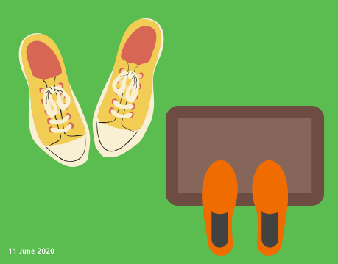


Myth Buster: COVID-19 can be transmitted by mosquitoes, your shoes, and 5G Networks.
COVID-19 is not spread by mosquitoes or 5G Networks.
The risk is low of getting infected by the virus on shoes. Leave your shoes at the door as a precaution.
Remember, the main way it is spread is by respiratory droplets.
Notes:
World Health Organization, Coronavirus Disease Advice for the Public: Mythbusters (2020) accessed on August 20, 2020, at https://www.who.int/emergencies/diseases/novel-coronavirus-2019/advice-for-public/myth-busters.
Dialogue:
False news can bring real harm. We need to make decisions based upon reliable information. Let’s look at each one of these to decide if they are likely to be true.
1. This illness is not transmitted by 5G Networks. We know this because COVID-19 outbreaks have taken place in other countries that do not have 5G Networks. This illness is caused by a new coronavirus that is spread by respiratory droplets.
2. The likelihood of COVID-19 being spread on shoes and infecting someone is very low. As a precautionary measure, consider leaving your shoes at the entrance to your home. This will help prevent contact with dirt or waste that may be on the soles.
3. Mosquitoes and house flies do not transmit COVID-19. It is a respiratory illness.

Slide 7
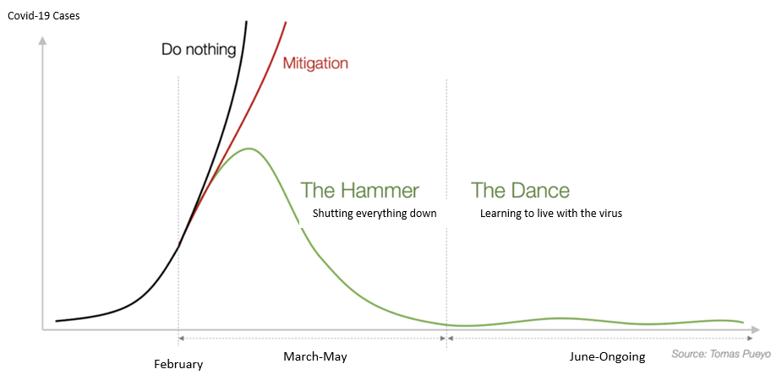
New Brunswick FLATTENED THE CURVE
…and now we dance
Reducing risk and spread
“The Dance”- easing restrictions while using protective measures to reduce the risk of large outbreaks.
Notes:
As described in the chart above – February was the “do nothing” phase. The virus was new, unknown and the curve was on the rise. The Hammer: March-May, when everything shut down and we learned more about the virus. The curve started sloping down as spread was controlled. The Dance: June-Ongoing, involves easing the restrictions while using protective measures to reduce the risk of further large outbreaks. The dance is difficult work, and involves everyone working together.

Slide 8

Physical Distance of at least 2 metres
How to decrease your risk of getting COVID-19
Frequent hand cleaning. Keep hands away from your face.
Wear a community mask, if 2 metres physical distance is not possible
Notes:
(Public Health Agency of Canada, 2020)

Slide 9
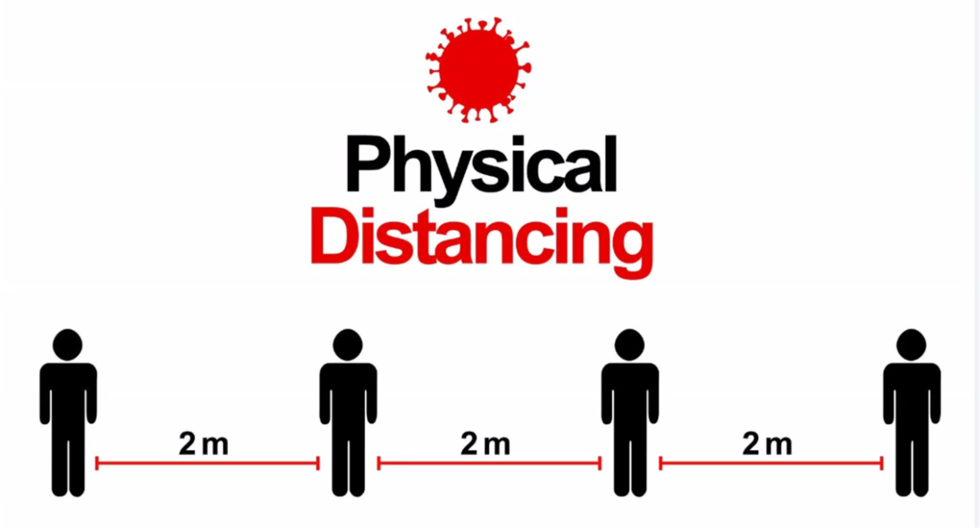

Stay At Least 2 Metres Apart.
A Little Space Can Make a Big Difference!
Notes:
(WorkSafe NB, 2020)

Slide 10
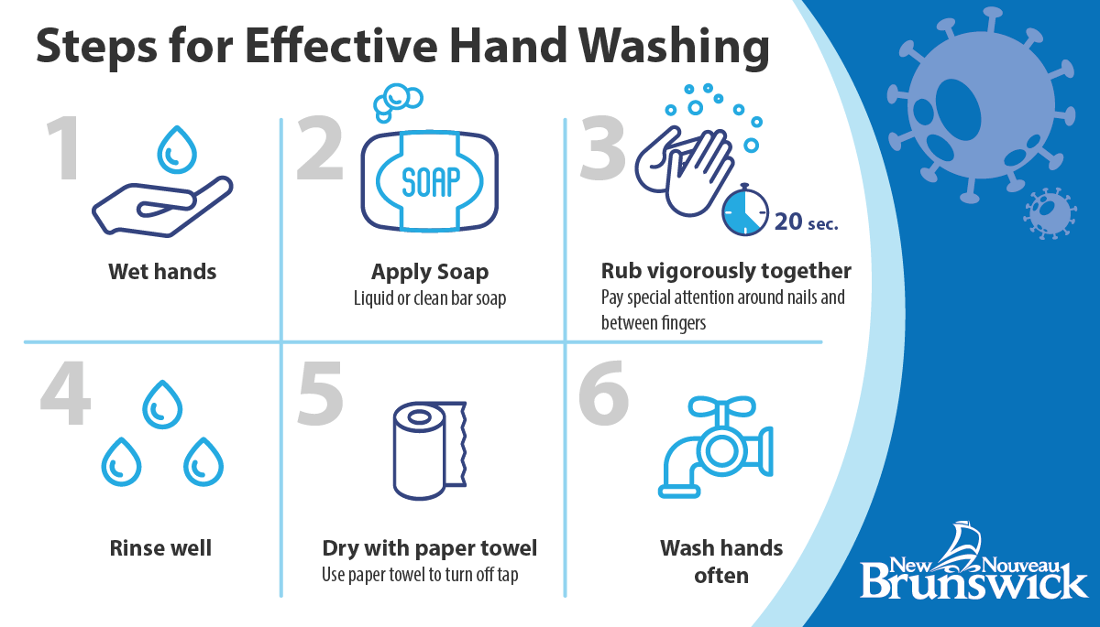
Notes:
By now, this should be second nature for you. Remember to scrub your hands, paying attention to both sides of your hands, your nails and between your fingers. Just like in elementary school, sing your abc’s to pace yourself (Government of New Brunswick, 2020)

Slide 11
Tips for Using Hand Sanitizer
Step 1
Dime size drop of sanitizer on hand
Step 2
Rub hands together, including between fingers
Step 3
Keep rubbing until hands dry, about 20 seconds
Hand sanitizer with no added scent is a good option when hands do not look dirty.
Alcohol-free, no added scent hand sanitizer will be available at schools
  Entrances
  Classrooms
  Common areas – library, gym, cafeteria, etc.

Slide 12
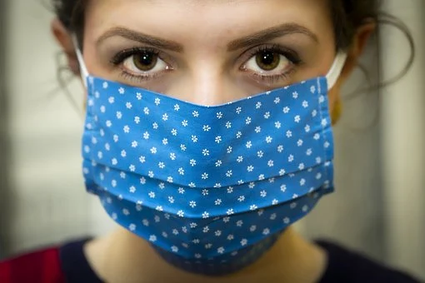
Wear a Community Mask When Necessary
While 2 metres of physical distance is best; when this is not possible a community mask is recommended.
A mask should:
cover the nose and mouth,
have 2 layers of tightly woven fabric,
not have an exhalation valve.
Click here to see a short video
Notes:
Image Pixabay https://cdn.pixabay.com/photo/2020/03/26/09/06/covid-19-4969674__340.jpg
Government of Canada, Non-medical masks and face coverings (2020) accessed on August 20,2020 at https://www.canada.ca/en/public-health/services/diseases/2019-novel-coronavirus-infection/prevention-risks/about-non-medical-masks-face-coverings.html).
Health Canada Video: https://www.youtube.com/watch?v=gvLA--hGU70&feature=youtu.be
Transcript
Text on-screen from step 1 to step 9: COVID-19: How to wear a non-medical mask or face covering properly
To continue to limit the spread of COVID-19, here’s how to wear a non-medical mask or face covering when physical distancing is difficult.
Text on-screen: Step 1: Wash your hands before use
Start by washing your hands with soap for 20 seconds.
Text on-screen: Step 2: Use loops or ties to place mask over nose and mouth, and secure it
Then, pick up the mask by the ties or loops, place it over your nose and mouth, and secure it behind your head or ears.
Text on-screen: Step 3: Adjust mask if needed
From there, adjust the mask to ensure your nose and mouth are fully covered, so there are no gaps. Then wash your hands again.
Text on-screen: Step 4: Avoid touching the mask
While wearing the mask, avoid touching it or touching your face. And wash your hands if you do.
Text on-screen: Step 5: Remove using the loops
Once you’re done using the mask, remove it by the ties or loops without touching the front.
Text on-screen: Step 6: Fold and place inside a clean bag
Fold the outer parts of the mask together, and place it in a clean bag to wash later. Or if it's a single-use mask, throw it out in the garbage. Then wash your hands right away.
WHO – research showing some protection for wearer
protection for the person you are close to
Text on-screen: Step 7: Change if moist, dirty or damaged
Change your mask whenever it becomes moist, dirty or damaged.
Text on-screen: Step 8: Don’t hang from your neck or ears
Don’t leave the mask hanging from your neck or ears.
Text on-screen: Step 9: Wash your hands after use
And remember: always wash your hands after using a mask.
Text on-screen: When you wear a mask, you’re protecting others around you.
But a mask alone will not prevent the spread of COVID-19. So continue frequent hand washing, practising physical distancing and staying home if you’re sick. Let’s protect each other. Learn more at Canada.ca/coronavirus (Government of Canada, How to wear a non-medical mask (2020) accessed on August 20, 2020 at https://www.youtube.com/watch?v=gvLA--hGU70&feature=youtu.be.

Slide 13
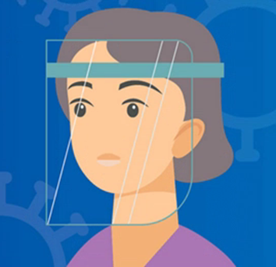
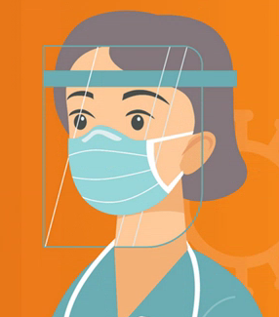
Myth Buster: Face visors/shields are just as effective as masks for COVID-19 protection.
False. Face visors/shields without wearing a mask does not provide effective protection against COVID-19.
Notes:
False. Visors alone provide ineffective protection against COVID-19. A mask is more protective because it covers the mouth and nose, to reduce droplet spread when people cough, talk or sneeze. If you choose to wear a visor, wear a mask, as well (World Health Organization, 2020)

Slide 14
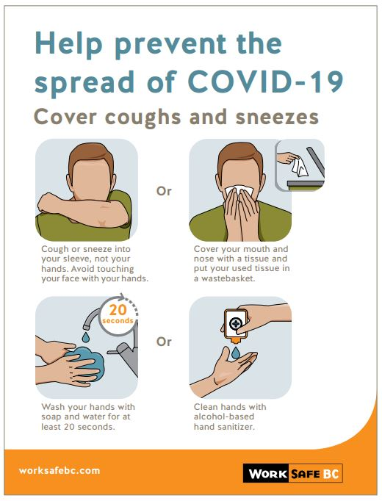
Use
Cough
and
Sneeze Etiquette
OR
Into your arm not your hand
Into a tissue and throw in the garbage
OR
Wash your hands with soap and water for 20 seconds
Use hand sanitizer
Adapted from
Notes:
Adapted from WorkSafe BC (2020)

Slide 15
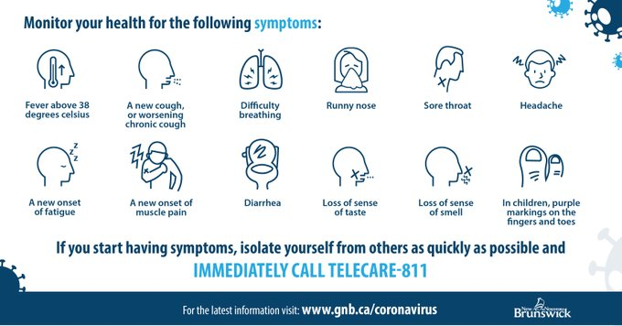
Check Your Child Every Day
Before They Leave for School.
If your child has 2 or more of these symptoms:
Purple marks on children’s fingers or toes
Keep your child home from school and call Telecare 811 or your primary healthcare provider for advice.
Notes:
Adapted from Government of New Brunswick, 2020

Slide 16
Outbreak Management
An outbreak of COVID-19 is defined as one positive case.
The Regional Medical Office of Health will contact the school or the school district if a positive case of COVID-19 is confirmed.
The school principal must follow the orders of the Regional Public Health Office.
Public Health will, through contact tracing and risk management, make decisions about who needs to self-isolate. This may require an individual or several individuals, a classroom or multiple classrooms or even a school population to self-isolate.
Public Health will inform these individuals of when they can return to school.
Click here for more information in the Return to School: Guide for Parents and the Public September 2020
Notes:
EECD Return to School Sept 2020 Parent and Public

Slide 17
Taking the BUS to School….
While waiting for the bus
Children should keep 2 meters apart from those not in
their bubble (household/classmate)
On the bus
Grade K to 12 wear a mask while boarding and exiting the bus
Sit in assigned seat
K to grade 5 – one child per seat or 2 from same household
Grade 6-12 – required to wear a mask if NOT sitting with someone from the same household
Notes:
(Anglophone South School District Return to School Operational Plan, 2020)

Slide 18
Walking or Driving to School…
Walking to school
Children should keep 2 meters apart from those not in their bubble (household/classmate/close friend)
Remind your child about walking safely. Walk on sidewalks. If no sidewalk, walk on the left side of the road facing traffic.
Driving Children to School
If you drive children to school that do not live with you, keep track of the dates and times you drive them.
Notes:
(Anglophone South School District Return to School Operational Plan, 2020)

Slide 19
At School
Your child will be directed:
Where to go
How to move within the school
How to exit the school
Grades | School
K - 2 | As close to 15 students per group, as possible
3 - 5 | As close to 22 students per group, as possible
6 - 8 | Regular class size, in group
9-12 | Blended learning between school and home
Notes:
While waiting to enter, remain 2 meters apart from others. Wear a mask when this is not possible.
(Anglophone South School District Return to School Operational Plan, 2020)

Slide 20
Use of Community Masks and Physical Distancing for Students
K-5 Smaller class sizes, stay in group | In class grouping | Community masks | Not required
 |  | Physical distance | Not required*
 | In common areas where class grouping is not protected | Community masks | Encouraged
 |  | Physical distance | 2 meters
6-8 Same class size, stay in group | In class grouping | Community masks | Not required
 |  | Physical distance | Not required*
 | In common areas | Community masks | Required
 |  | Physical distance | 2 meters
9-12 Smaller class size | In the classroom | Community masks | If unable to space by 1m
 |  | Physical distance | 1 meter
 | In common areas | Community masks | Required
 |  | Physical distance | Two meters
*Students will be taught age appropriate ways to distance and promote hygiene etiquette
Notes:
Adapted from the Anglophone South School District Return to School Operational Plan (2020)

Slide 21

Who is Allowed to Enter a School?
Students
School Personnel, including visiting teachers and other school personnel who travel between schools.
Other essential services, as approved by the principal (i.e. Social Workers, Public Health Nurses, WorkSafe NB Officers, volunteers, etc.).
Drop-in or unplanned visits by parents and guardians will be limited and not encouraged. Appointment is preferred.
Notes:
Anglophone South School District Operational Plan (2020). Certain regulatory officers, such as WorkSafe NB and Public Health representatives may do spot checks. Access is to be provided and appropriate health and safety measures followed.
Parent meetings may be scheduled by appointment.

Slide 22
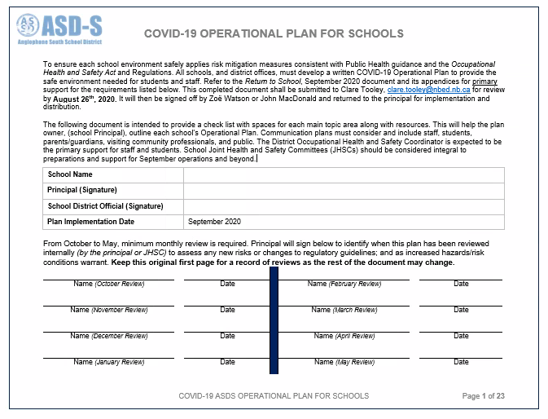
School Operational Plan
Your school’s operational plan can be accessed on your child’s school website starting September 3, 2020.
If you have any questions about the plan, contact the school principal.
Notes:
(Anglophone South School District Return to School Operational Plan, 2020)

Slide 23
Vulnerable Students
Families should discuss with their health-care provider to determine if their child should physically attend school.
For students advised by their healthcare provider to stay home from school, the school, ASD-S and the Educational Support Services Teams consider the individual student’s needs when planning the student’s school year.
Note: include a student’s needs such as: physical health, mental health or any other circumstance that requires them to learn at home.
Notes:
(Anglophone South School District Return to School, 2020)

Slide 24
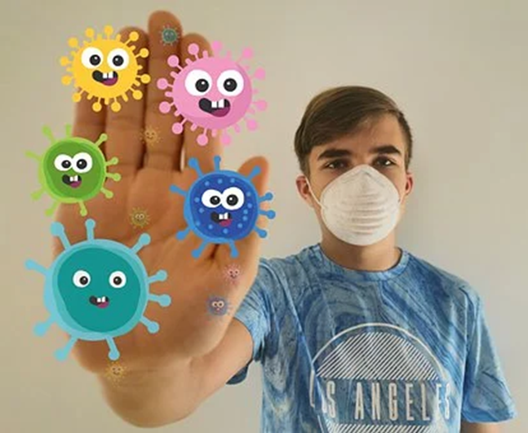
If Your Child Feels Sick at School…
They should tell their teacher or another adult.
School staff will call the child’s parent or emergency contact .
Your school will have a designated area away from others where they will wear their mask while waiting to be picked up.
Please arrange to pick up your child within 1 hour of receiving a call.
It is important to have a backup plan for unexpected times that your child needs to be picked ups at school
Notes:
(Anglophone South School District’s Return to School Guide, 2020)

Slide 25
If someone who lives in your house gets tested for COVID-19…
Everyone in the home should stay home and self-isolate until the test results are known.
If over 16 years of age and has an NB Medicare number, they will be given directions on how to access their results online
Public health will call anyone less than 16 years old or over 16 years old who does not have a NB Medicare number with the test results
Positive Test Results:
Public Health will provide directions about self-isolation and will do contact tracing.
Negative Test Results:
If the test is negative, stay home symptoms are gone or your healthcare provider says you can return to school/work. If you had a fever you must be fever free for 24 hours without the use of medication to treat the fever i.e. acetaminophen, ibuprofen before returning.

Slide 26
Mental Health During COVID-19
It is natural to feel stress, anxiety, grief, and worry during and after stressful situations like a pandemic.
When parents and caregivers are able to deal with the COVID-19 calmly and confidently, they provide the best support for their children.
Reaching out for help is not a sign of weakness; it is a sign of strength.
ASD-S: school guidance counsellors and Child and Youth Team
CHIMO Helpline: Help is just a call away at 1-800-667-5005
Hope for Wellness Helpline: offers counselling and crisis intervention o all Indigenous people across Canada: 1-855-242-3310
  Kids Help Phone - Text TALK to 686868 or call 1-800-668-6868 to chat
with a volunteer Crisis Responder 24/7.
Notes:
Government of New Brunswick, Mental Health During COVID-19 (2020). Accessed on August 20, 2020 at https://www2.gnb.ca/content/dam/gnb/Departments/h-s/pdf/mental_health_factsheet_parentsguardians_EN.pdf
.
Guidelines for Re-Entry into the School Setting During the Pandemic: Managing Social, Emotional and Traumatic Impact NACTATR Guide to School Re-Entryhttps://nactatr.com/news/guidere-entry.html
(GNB, 2020)

Slide 27

Thank You!
For further information, please consult with your school administrator, or the Anglophone South School District Office.
1-506-658-5300
ASD-S website
Return to School: Guide for Parents and Public Sept 2020
Government of New Brunswick COVID-19 website
Stay Connected for Updates:
Twitter: @ASDS_South
Facebook: @AngloSouthSchools
Notes:
This Photo by Unknown Author is licensed under CC BY-SA-NC

